Slide 1
STats4sd Datasets tracker
The tools for the datasets

Slide 2
The purpose
The purpose of this tool is to allow Stats4SD to have access to the datasets that we have and how they are organized by project.
It provide a central location to store the raw datasets that we receive from clients.
It allow us to keep track of who has created copies of the data and what purposes. Also, we can ensure that if we need to delete a dataset, we can easily track all versions of that dataset.

Slide 3
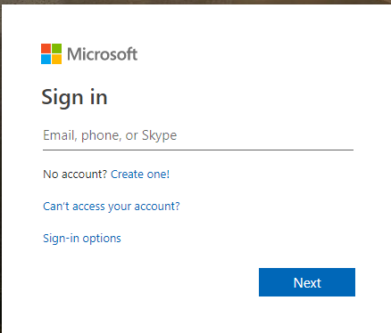
login
The login for the first time required:
email and password, if you already have an account.
create an account, if you don’t have one.

Slide 4
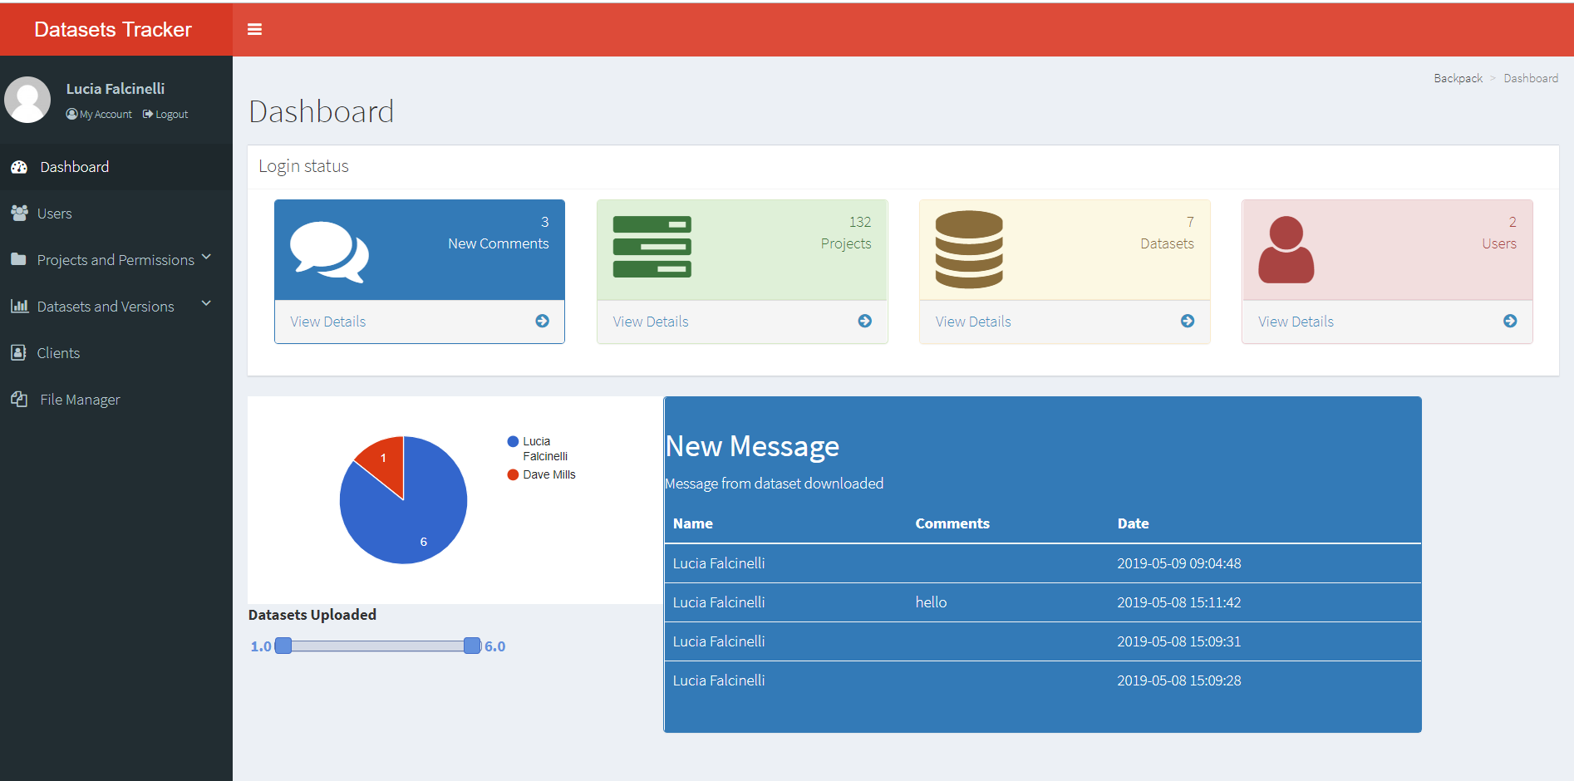
Dashboard

Slide 5
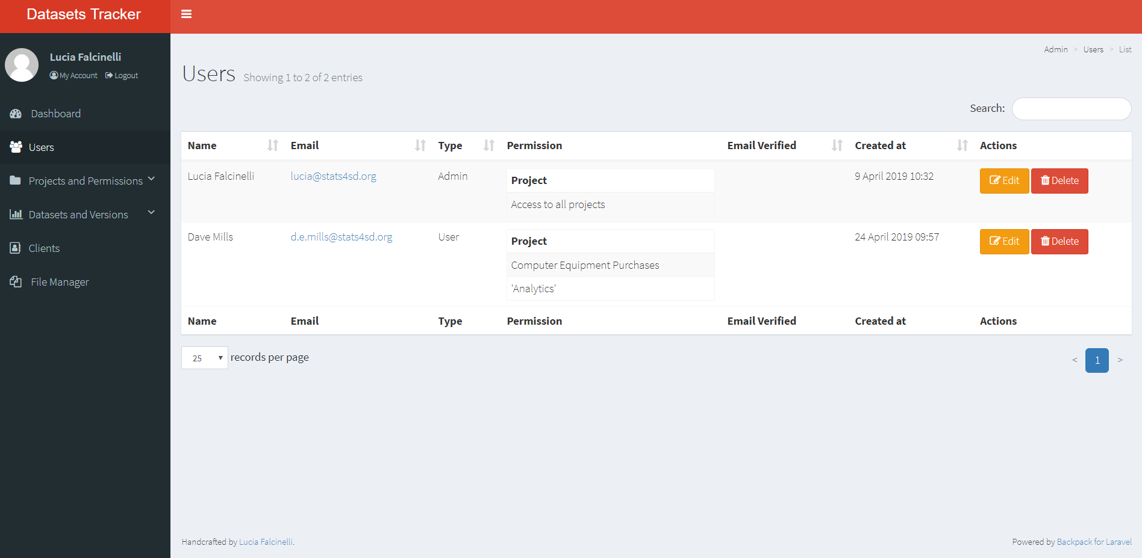
users

Slide 6
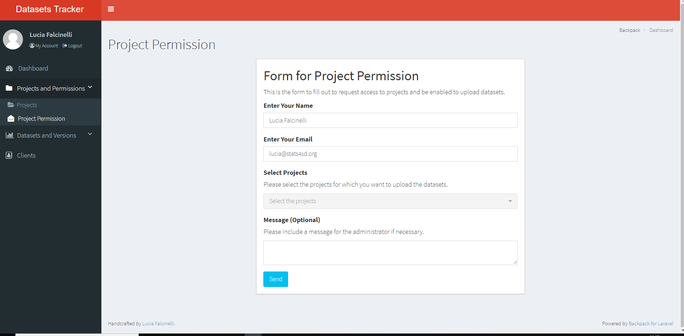
Project Permission
Send an email to the administrator who will enable the user to access the projects.
It is possible to include a message for the administrator

Slide 7
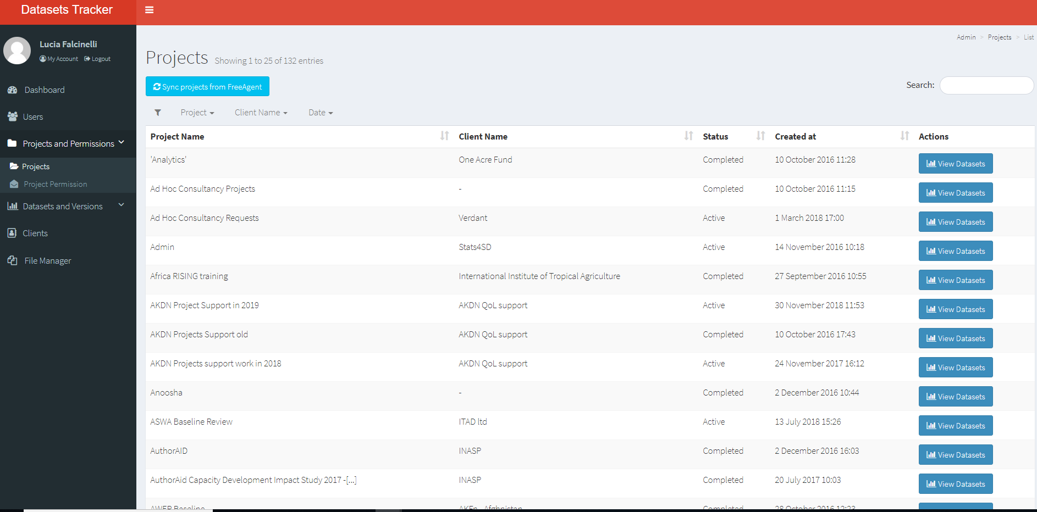
Projects for admin

Slide 8
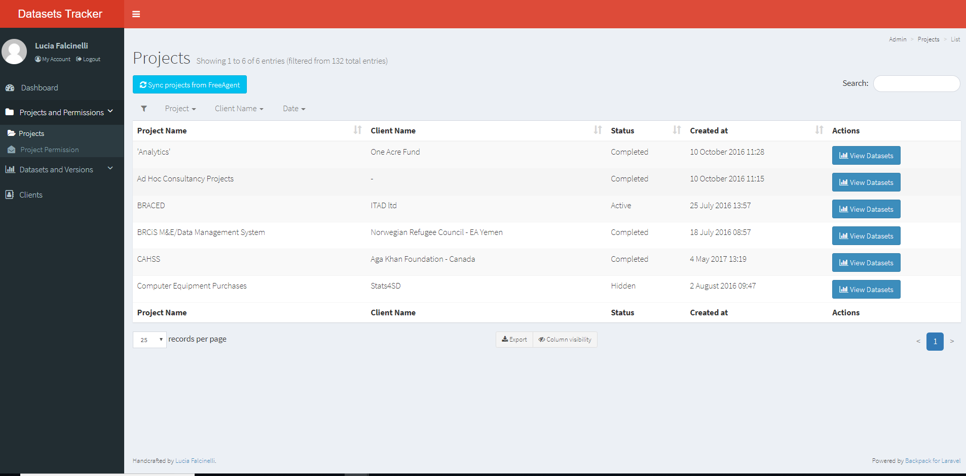
Projects for users

Slide 9
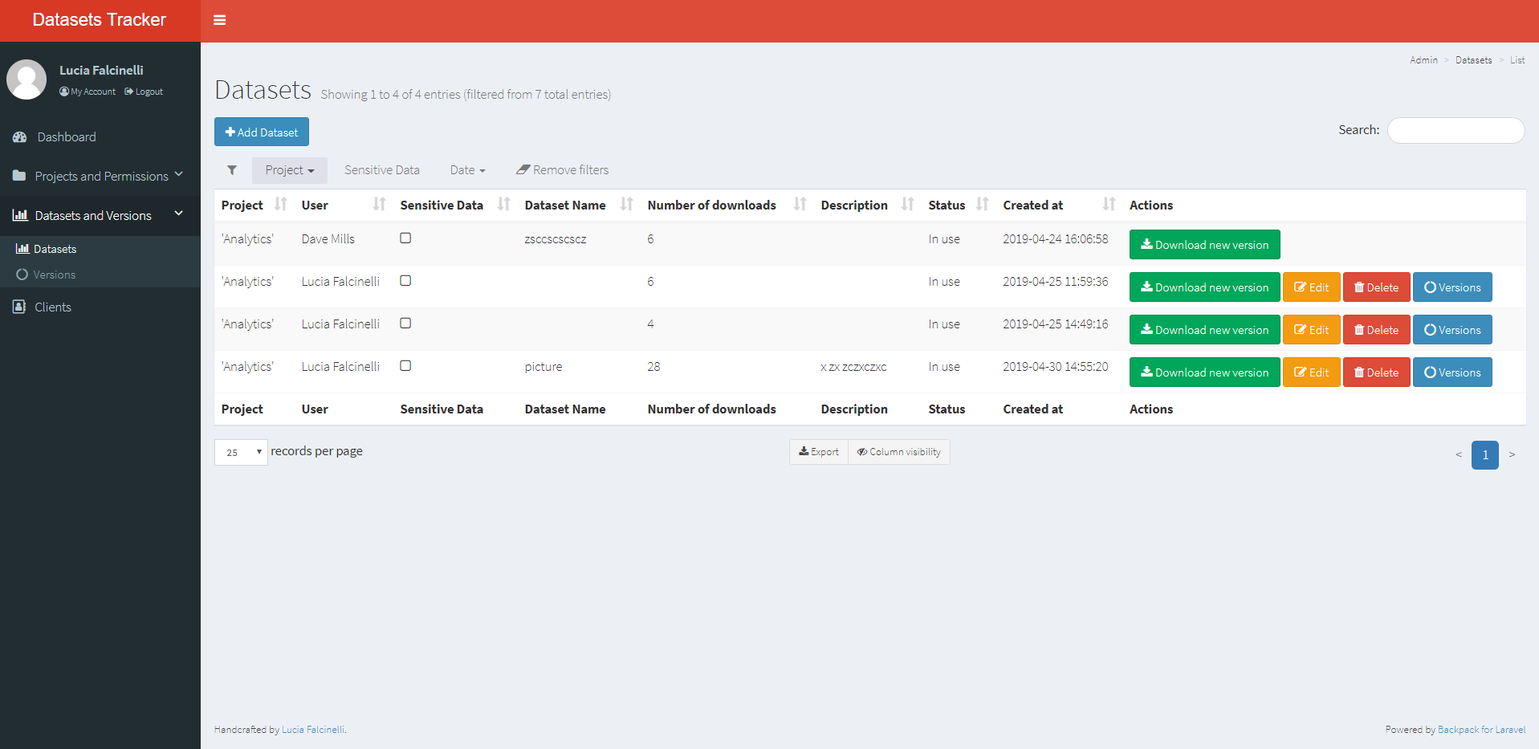
Datasets
Add Dataset from Button
Filter by project
Sensitive data
Filter by date
Only the person who uploads the dataset is responsible for the delete and for the update.
Who has access to the project can download all the datasets.

Slide 10
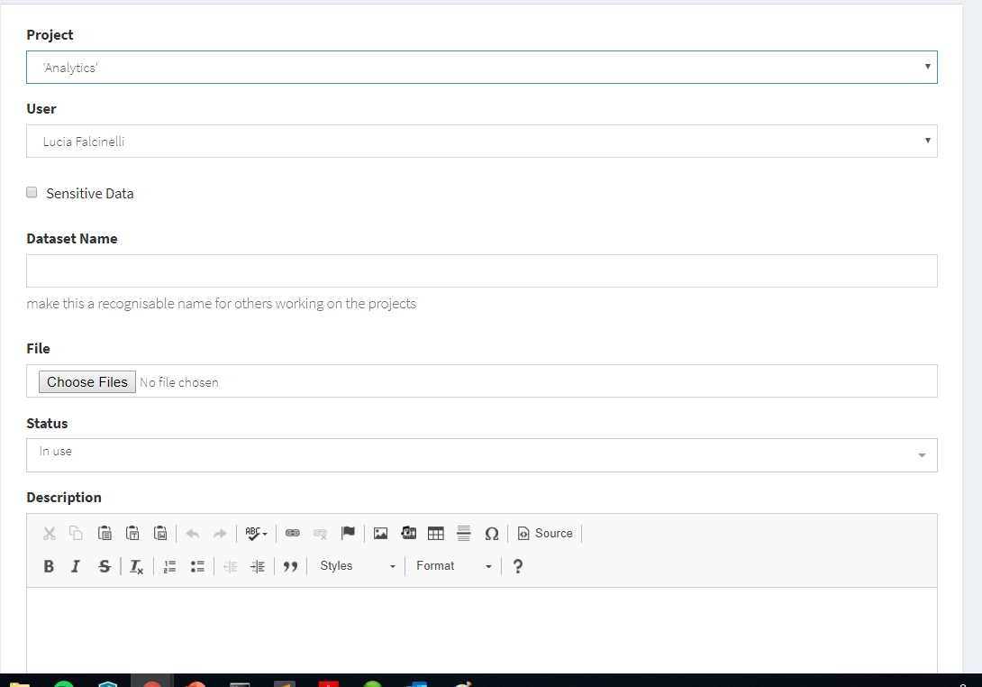
Upload a Dataset
Project and User fields are automatically compilated
Does the dataset include sensitive data?
Datasets name helps to identify datasets for other users
Status is ‘in use’ by default
Include a brief description or comment

Slide 11
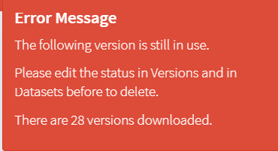
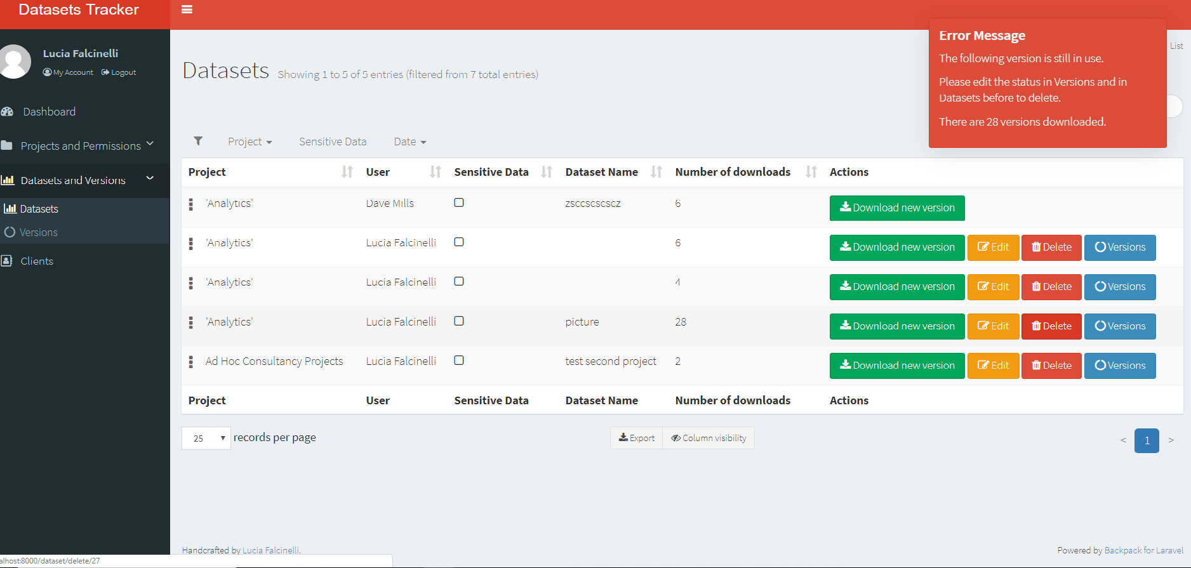
Delete a dataset
Use the button versions to change the status of the datasets and to delete the datasets

Slide 12
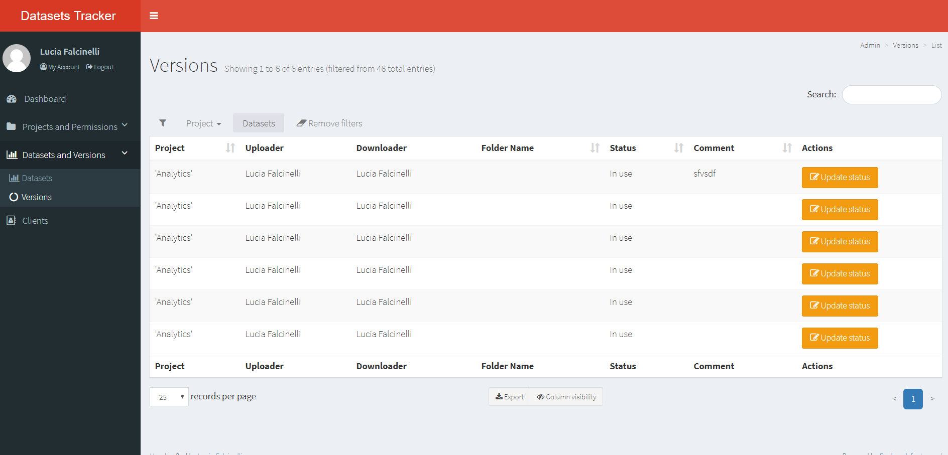
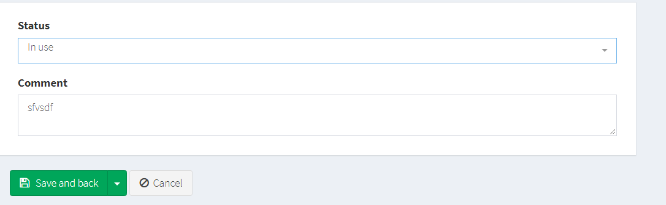
Update status versions

Slide 13
Thank you for your time

